Slide 1
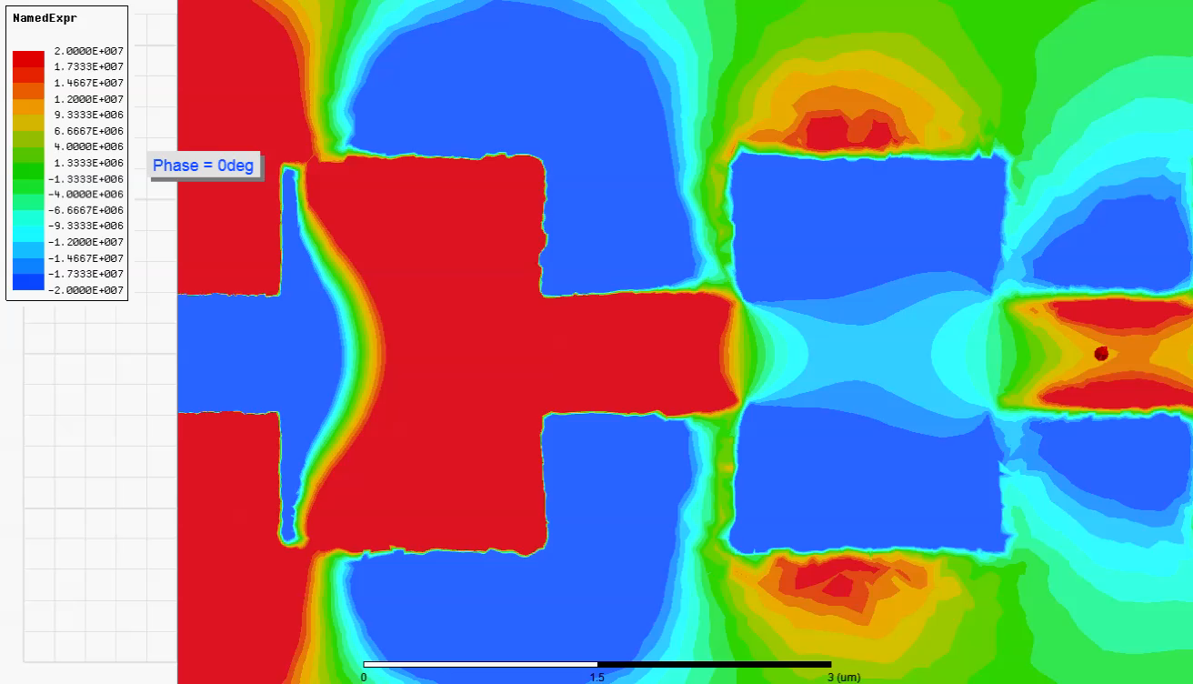
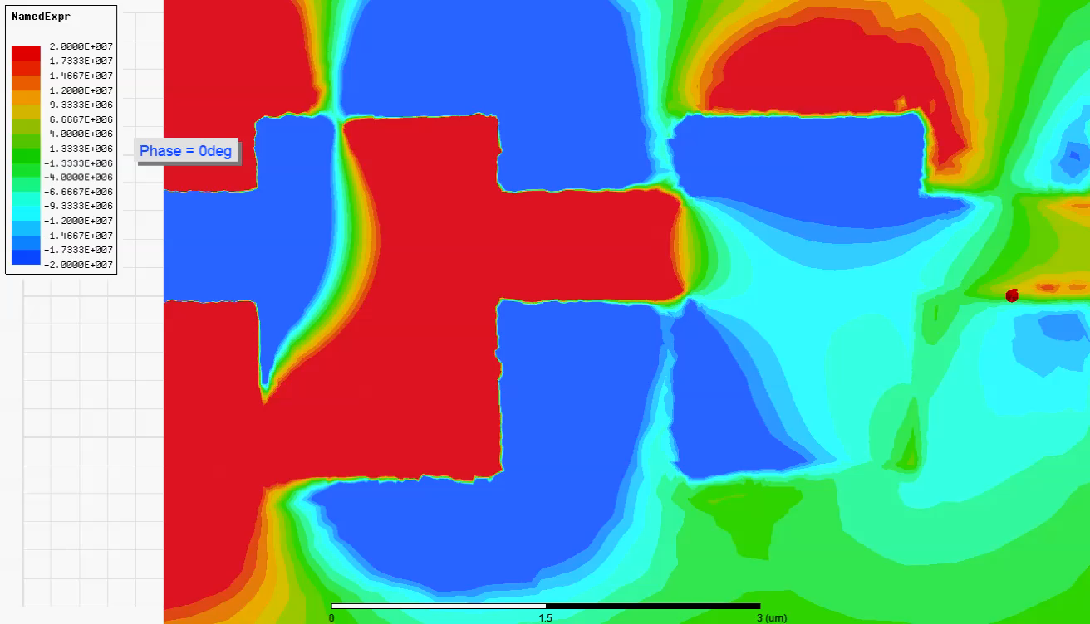
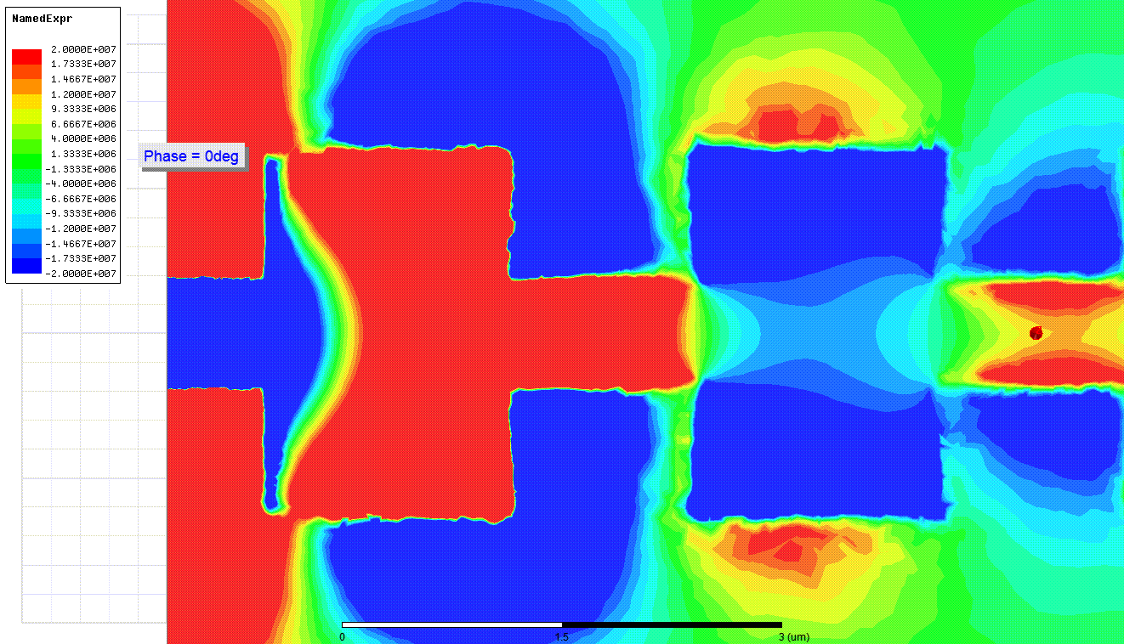
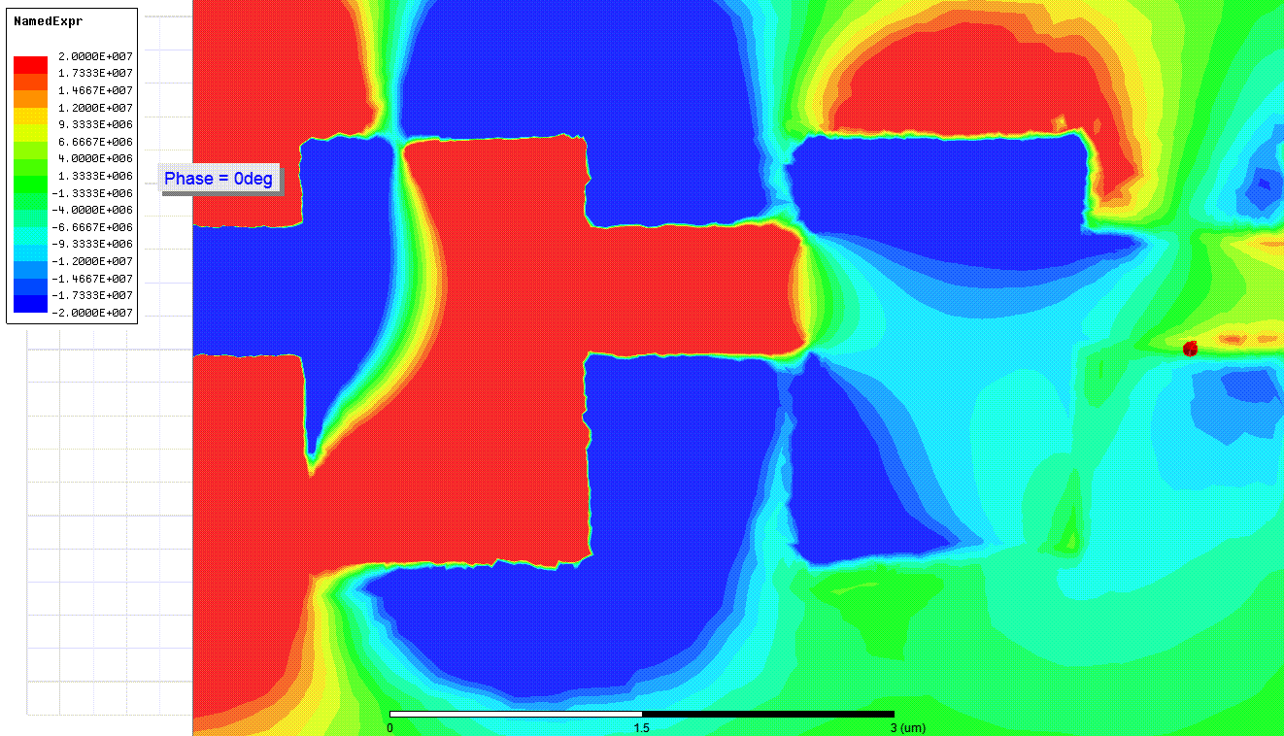
Y
X
Linearly Polarized (Symmetric) Leaky-Wave Design
Video and Gif
Circularly Polarized (Symmetric) Leaky-Wave Design
Video and Gif
(Gifs can apparently only be viewed in a slideshow)

